Slide 1
BlindSpotter
Sherwin | Joo Chuen | Wong Chong | Jing Jie | Evelyn
Group 7

Slide 2

Notes:
Check ur blindspots!

Slide 3
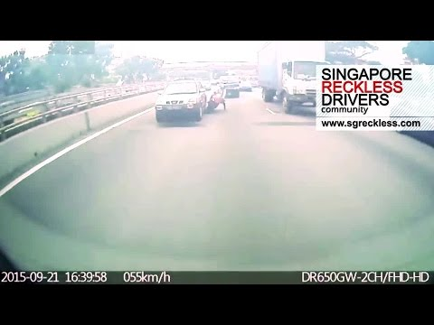

Slide 4
“Almost bang the car in front while checking blind spot.”
“Change lane forget check.”
“Can’t see properly at night.”
“Not suited for older people.”
Interviewees:

Slide 5
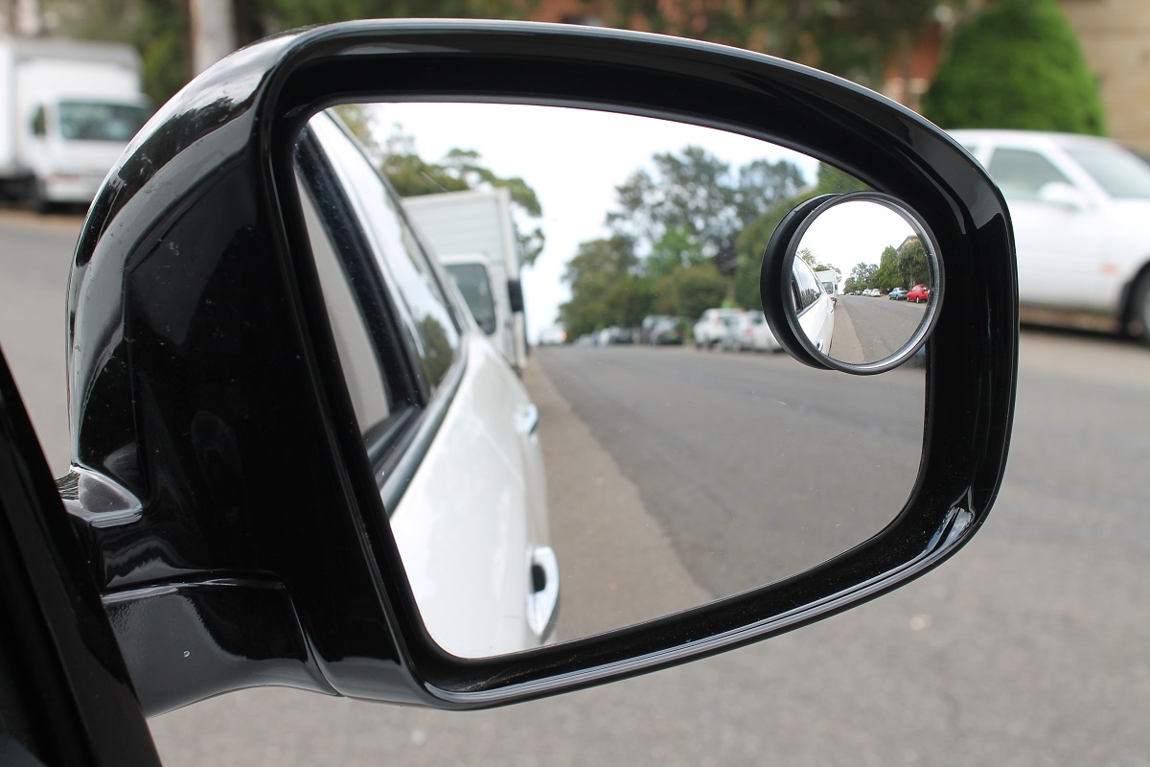
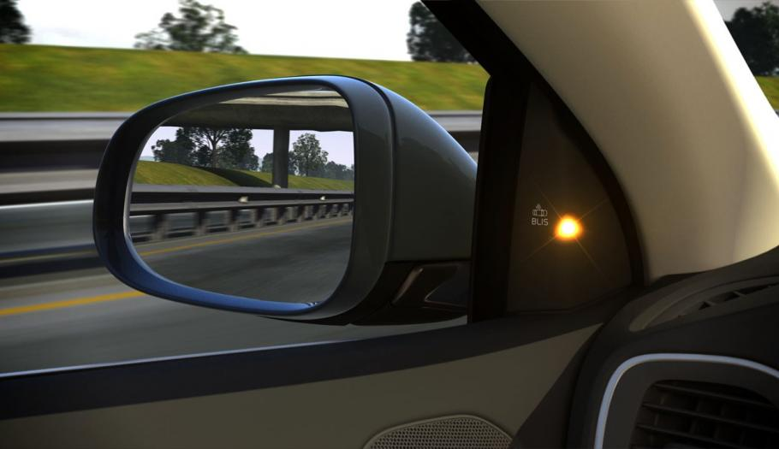
What is the business about?
RETRO-FITTED / IN-BUILT ELECTRONIC SYSTEMS
BLINDSPOTTER
Expensive
Intrusive
RUDIMENTARY SOLUTION
Low Resolution
Useless at Night

Slide 6
the BlindSpotter DISRUPTS THE MARKET by having an affordable blindspot device that functions just as well as the premium ones, and suitable for any vehicle.
What is the business about?

Slide 7
Market Opportunities

Slide 8
Growth opportunities
worth USD$ 32 million 92% willing to buy
Booming
Accessories Market
(Source: Automotive Industry Analysis 2016)

Slide 9
Rise of the Sharing Economy
Growth opportunities
9.6 million cars
TAM: 283 million USD$
Uber | Lyft | Zipcar
(Source: Automotive Industry Analysis 2016)

Slide 10
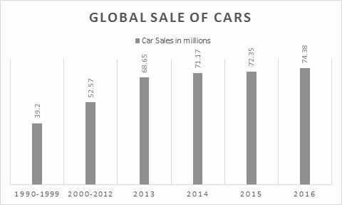
Growing
Growth opportunities
Car Sales
Projected to hit 100 million units by 2020

Slide 11
25.6 million cars
TAM: 725 million USD
(in major cities around the world)

Slide 12
61%
of the respondents say that they are
willing to purchase
BlindSpotter

Slide 13
Customer
Needs
Easy to install
Simple & Pleasant to use
Reliable
Durable

Slide 14
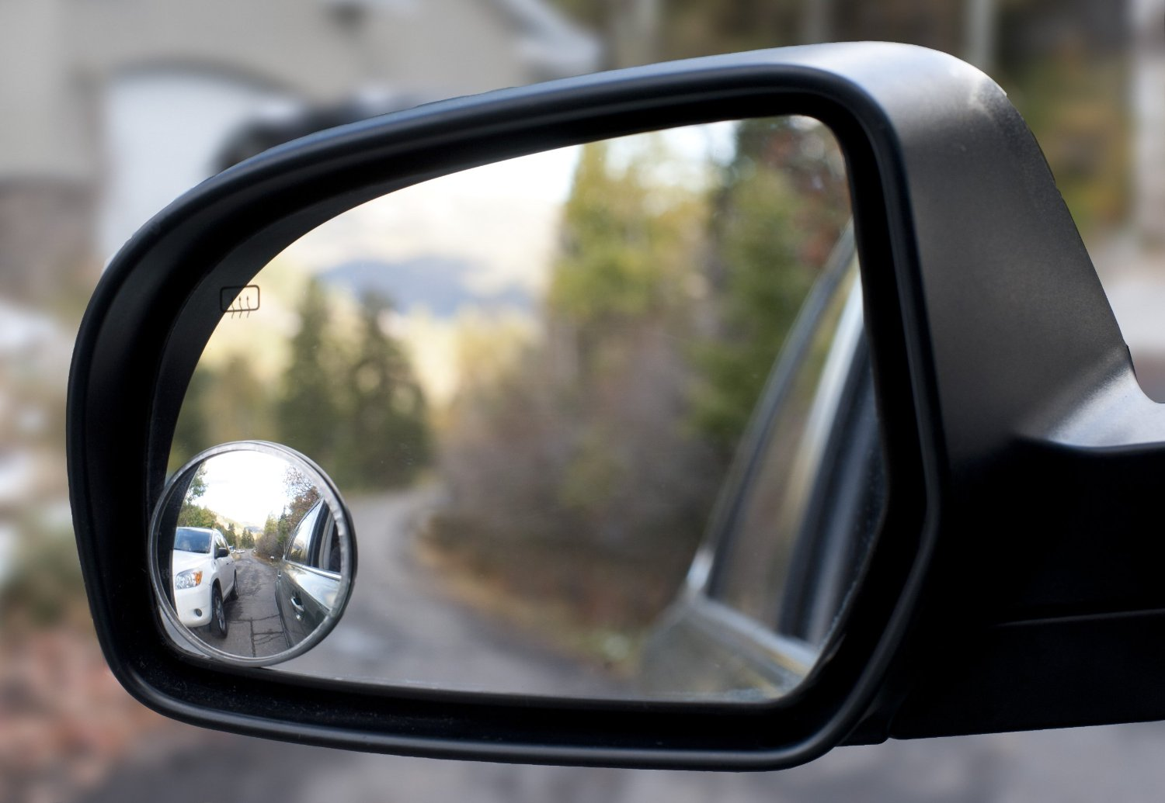
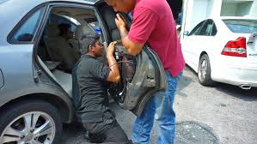
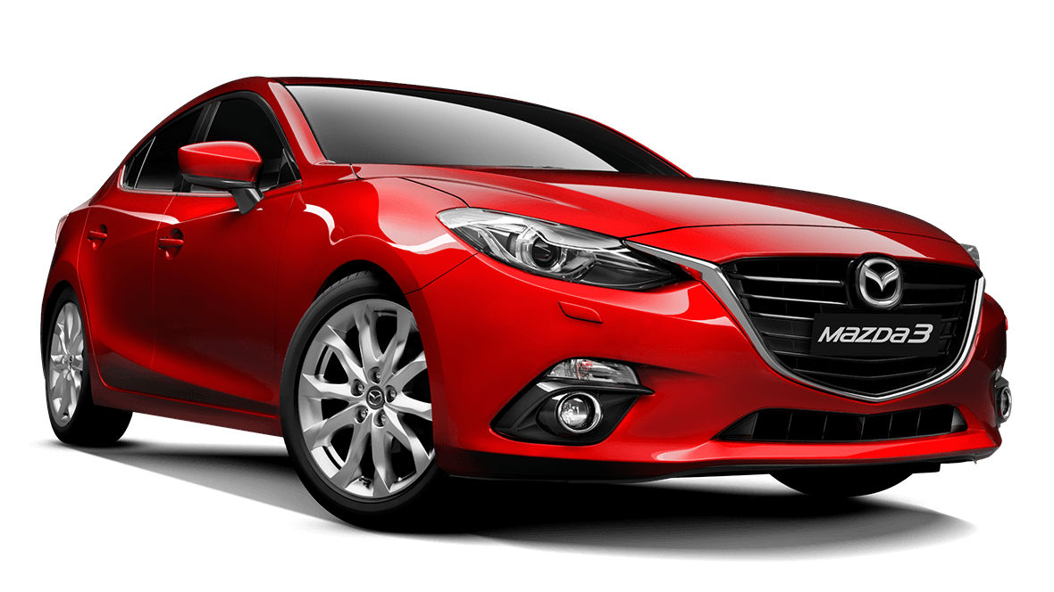
Comparisons to what is available in the market
Traditional blind spot mirror
Retro-fitted blind spot sensors
In-built monitoring systems
2 - 8 USD
119 USD
77,500 USD
Notes:
Competitors
Their price and features
Why they are successful or unsuccessful

Slide 15
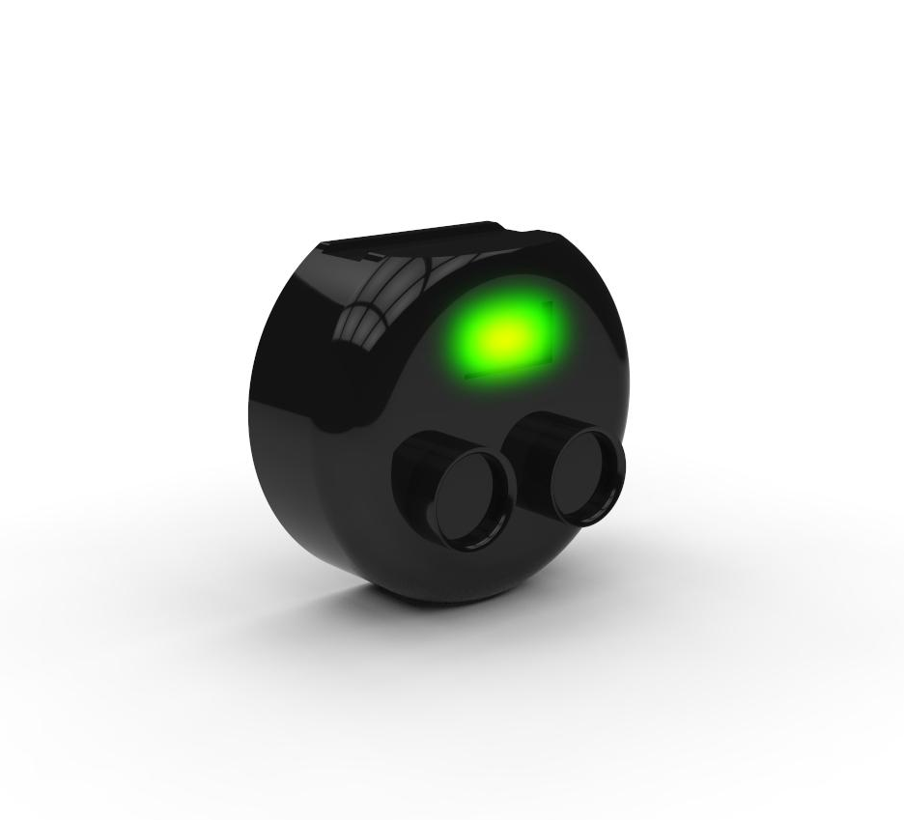
Value Proposition: Why is our solution better than the rest?
Solar panel for self-recharging
LED Array
Affordable
Reliable
Easy to install
Non-
intrusive
Universal for all cars
39.99 USD
Waterproof housing
Ultrasonic sensors
Notes:
The blind-spot detection device provides an affordable and reliable solution for vehicle users who wish to be safer on the roads. If it had not been for this device, users would either have to purchase new cars for a comprehensive in-built blindspot monitoring system.
Furthermore, only certain models have these systems in-built, the user might prefer a model that does not come with any in-built monitoring systems. In this case, our product is perfect for offering them an affordable and non-intrusive system.
In addition, the affordability and ease of installation allows current vehicle users of older cars to achieve the same functionality as that found in modern and better cars.
Regardless of the age or model of their cars, users can just purchase and stick on our affordable Blindspotter and achieve the same function found in premium and modern cars.

Slide 16
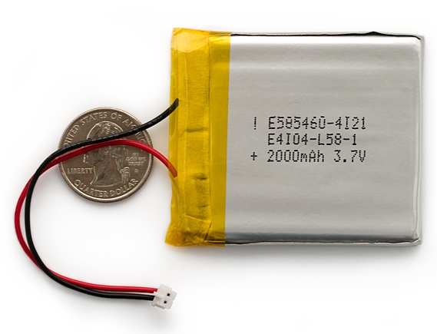

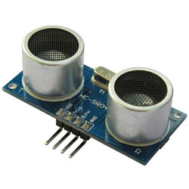
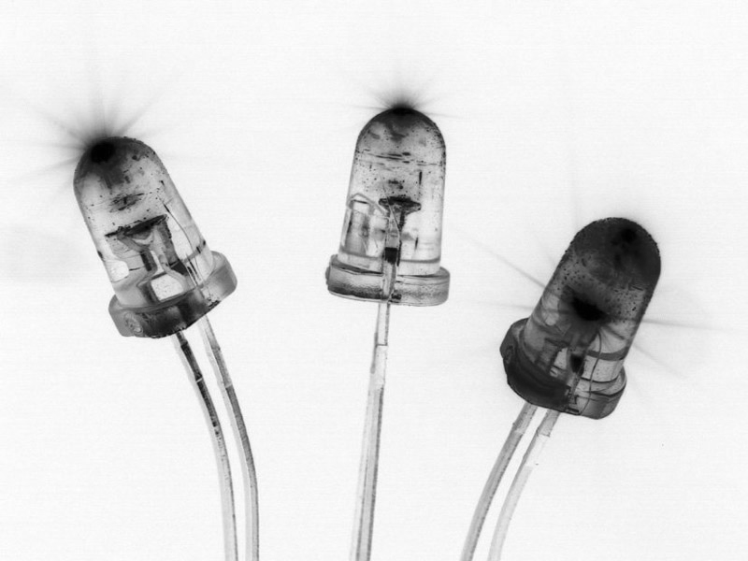
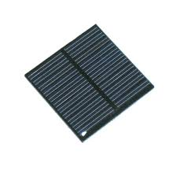
Product Breakdown
USD $5
USD $0.20
USD $0.80
USD $0.05
USD $5
Estimated Total Cost per unit = $12.83
Notes:
Outsource to contract manufacturer - cost of 12.83 usd each

Slide 17
Manufacturing Strategy
In-house
R & D
Proprietary Technology
Out-source
Contract and Mass-Manufacturing
Notes:
Employing the six sigma statistical process control, so as to reduce cost of defect

Slide 18
Inventory Planning
Wagner-Whitin Model
Allows for batch-ordering while balancing setup and inventory costs
Notes:
We plan to have a warehouse in Shenzhen, and ...

Slide 19
Target Market
Business-to-customer (B2C)
Business-to-business (B2B)
Licensing

Slide 20



Business-to-customer
Targeting all car owners
Distribution channels: Petrol station
Supermarket
Car workshop
Online store
Notes:
Car owner frequent these places, good avenue to increase our product presence

Slide 21






Business-to-business
Annual recurring fees
Companies: Uber
ComfortDelgro
LTA
SBS transit
SMRT
Rental Car Companies
Notes:
Steady income rate, complement erratic nature of b2c

Slide 22

Licensing / IP
License to automobile manufacturers
Up-front licensing fee: $10,000
Rolling royalties: 5% of profit

Slide 23


Marketing Strategy
Inbound Strategy: ,
Viral Video
Outbound Strategy: Advertisement on bus
Notes:
Engadget, gizmodo, wired

Slide 24
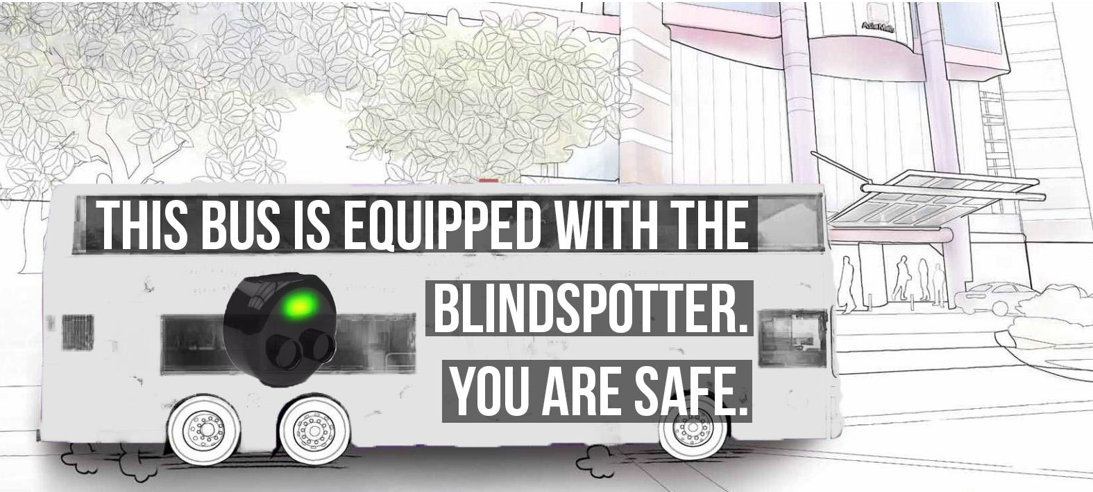

Slide 25
Sales Proposal: Value-based Pricing
Aim
Method
Analysis
Recalibrate

Slide 26
Sales Proposal: Expected Profit
Selling price:
39.99 USD
12.83 USD
27.16 USD per unit sold
Cost price:
Profit:

Slide 27
Risk Management
Risk | Solution
New Cars | Long term problem
Copy cats | File for patent before launch
 | Continuous R&D
Poor sales to customer | Expansion to other countries
 | Sell business to larger firm
Notes:
New cars taking over the market (it takes quite a long time to replace all old cars)
Copycat devices (file for patent before launching product)
Copycat devices (Constantly having RnD on our product, outsmart competitors)
Sales to customers not as good as predicted (Try in a different market in SEA)
Sales to customers not as good as predicted (Selling the business to larger car companies/accessories companies)

Slide 28
Where is the business headed?
TOKYO
SEOUL
GUANGZHOU
SINGAPORE

Slide 29
Plans for the future
Year 1: | Launch of product in Singapore
Year 2: | ComfortDelgro, SBS and SMRT to adopt technology & Product launch for Heavy Vehicles and Motorbikes
Year 3: | Launch of product in Guangzhou
Year 4: | Launch of product in Seoul
Year 5: | Launch of product in Tokyo

Slide 30
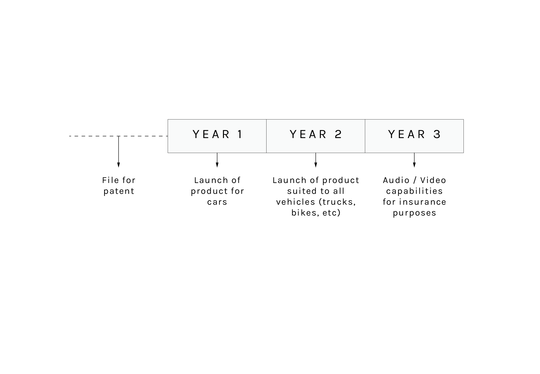
Product Roadmap

Slide 31
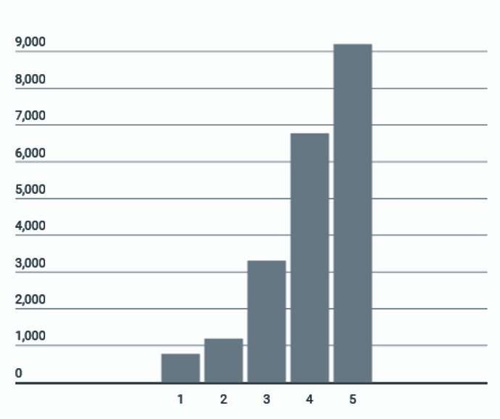
Projected Financials
Net income
(‘000)
Year

Slide 32
Safe roads, Save lives

